Slide 1






Contribute App
Team Members:
Sumanth Raja Ghanta
Varun Reddy Musku
Shruthi Battu
Rohan Reddy Kondaveeti
Tejaswini Challa
Chakradhar Prathivada

Slide 2
Contents
Android studio
Introduction
Solutions
Advantages
List of features
Flow chart
Version and project creation
Project Components
Usage of Genymotion.
Conclusion
Application Demo
Chakradhar

Slide 3
Android Studio
Android Studio provides a unified environment where you can build apps for Android phones, tablets, Android Wear, Android TV, and Android Auto.
The Android Studio comes with an Emulator that helps to start the entire app faster than the actual device.
Android Studio provides a visual drag and drops editor tool for working with XML files. This helps to create an entirely new app layout it is easy to develop.
Chakradhar

Slide 4
Introduction
In highly populated countries food and clothes wastage are disturbing issues. The streets, garbage bins and landfills have sample proof to prove it.
Marriages, restaurants, and family get-togethers expel out so much food and quick change in trends of fashion results in piling up of old clothes in your closet.
Shockingly, every second, the equivalent of one garbage truck of textiles is landfilled or burnt globally.
The high standard of living has resulted in the wastage of food, clothes, utensils etc. because of quick changes in habits and lifestyle.
Chakradhar

Slide 5
Solution
Instead of wasting these things we can put them in use by Contributing them to various organizations such as orphanages, old age homes and Homeless people, etc.
The product is an internet-based android application that basically aims at charity through donations.
The proposed application shall reduce food wastage and other requirements like clothes, books, utensils, etc. of needy organizations and peoples.
As mentioned above in the description there is a lot of food wastage that occurs daily at restaurants and cafes. Instead of throwing away as trash. It can be used for the needy. Benefiters will be both the restaurants/cafés (reducing the carbon footprint and wastage), and the needy.
Chakradhar

Slide 6
List of features
Splash screen
a) User
b)Goodwill
User Home Screen
a)Login
b)Register
c)About
Goodwill login Page
Dashboard
Donate
Receive
History
About US
Contact Us
Logout
Fire base
Sumanth

Slide 7
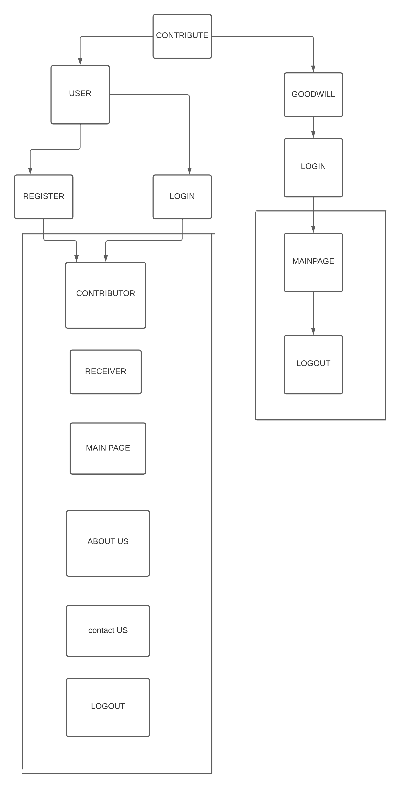
Flow Chart
Sumanth

Slide 8
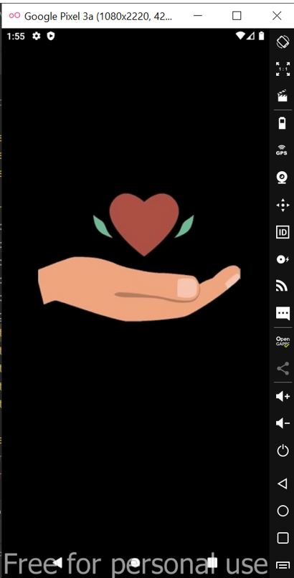
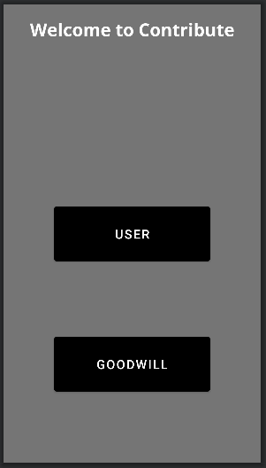
Splash Screen
Splash Screen is most commonly the first startup screen which appears when App is opened.
In other words, it is a simple constant screen for a fixed amount of time which is used to display the company logo, name, advertising content etc.
In splash screen we have created two buttons which is USER and GOOD WILL as shown in the fig.
When the user clicks the USER button, we will navigate to User Home screen.
When GOODWILL clicks the Goodwill button, they will go to GOODWILL login page
Sumanth

Slide 9
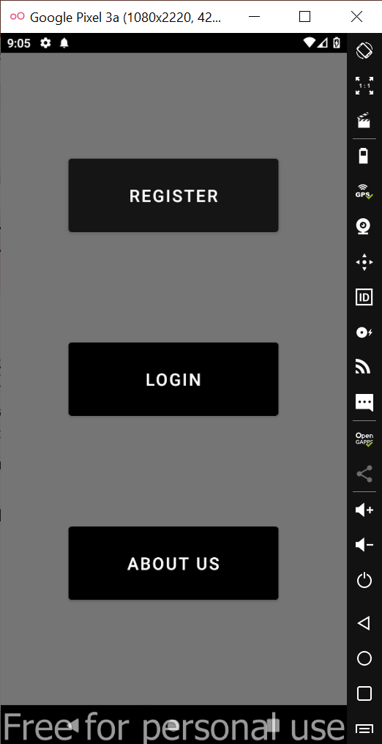
LANDING PAGE
User is provided with ways of interacting with the application like If user is relatively new, he needs to complete the Registration.
If user is already registered, they can directly login with their credentials.
In order to know about the applications, user can navigate to About us page.
Tejaswini

Slide 10
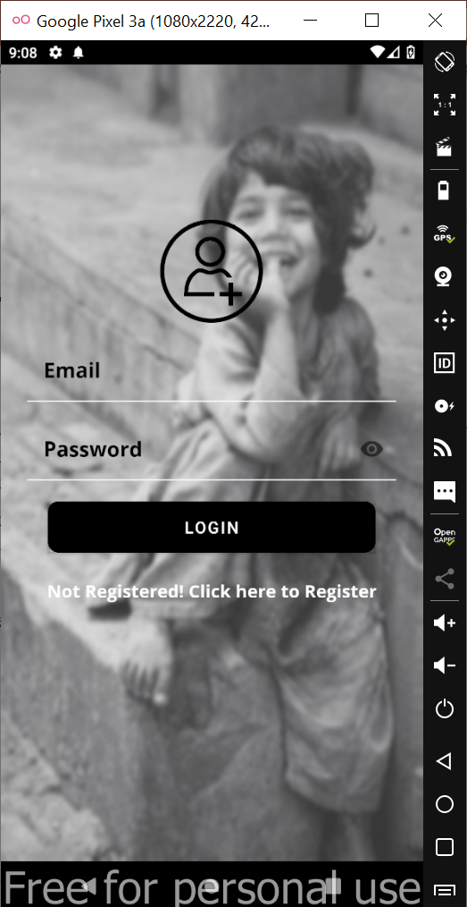
LOGIN LAYOUT
A login page is an entry page to an app that requires user identification and authentication, regularly performed by entering a username and password combination.
Here we are using email (as a username) and password.
Password must be 10 characters or more and here we have implemented to view the entered password.
We can navigate to register page if the user is not registered yet.
Tejaswini

Slide 11
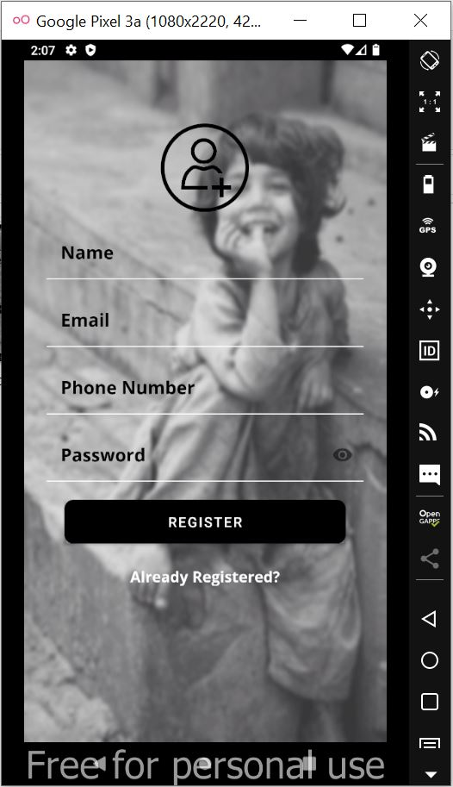
REGISTRATION LAYOUT
A signup page (also known as a registration page) enables users and organizations to independently register and gain access to your system.
We have different fields, and all the fields are mandatory to complete the registration.
If user is already registered, user can be navigated to login screen by using the Already registered? Feature.
Tejaswini

Slide 12
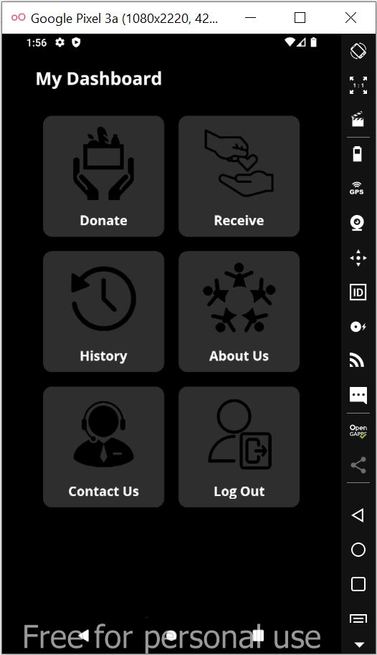
MY DASHBOARD
User can perform any activity.
Donate
Receive
History
About us
Contact Us
Logout
Varun

Slide 13
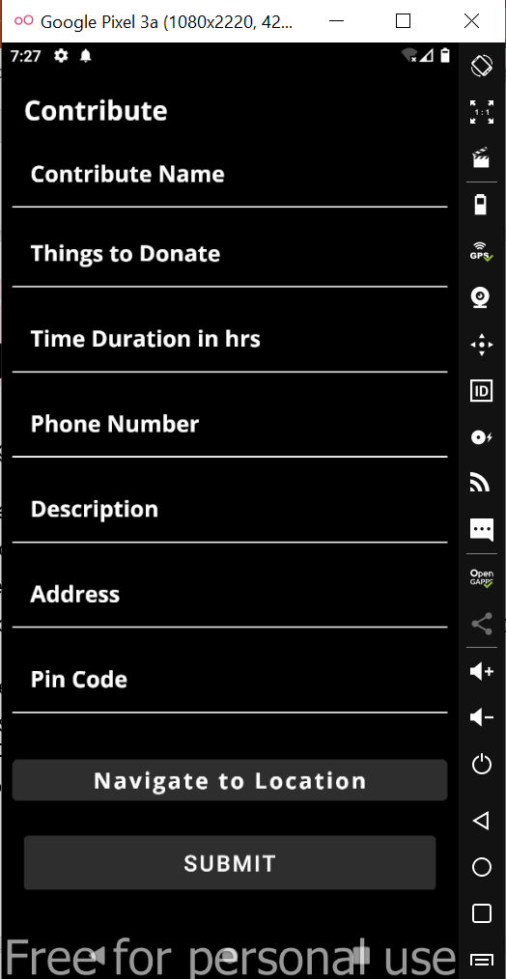
Contribute page
User is required to provide the information which includes Name, things to donate, Address and pin code as mandatory.
Donor can donate things like food, clothes, utensils etc.,
Details like Things to donate, Pin code, address, donor name Time duration and Navigation will be listed in History page after user submits the details.
Varun

Slide 14
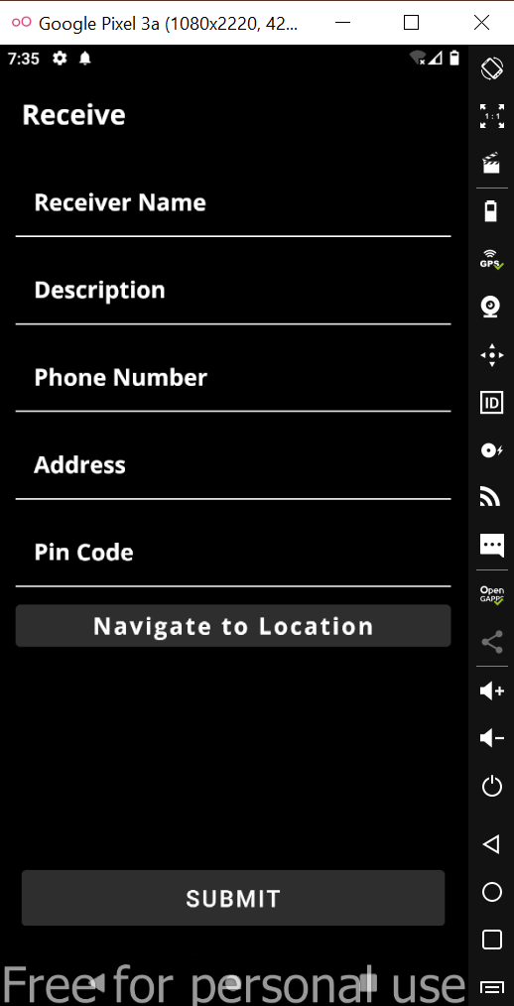
Receive
Receiver can receive any goods from the Donor and receiver can request what he needs.
All the information regarding request and receiver details will be stored in History page.
A user who needs the things they must submit their details in order to receive/request.
All the fields are made mandatory.
Here we have created Navigated button, the receiver will navigate to google maps.
Rohan

Slide 15
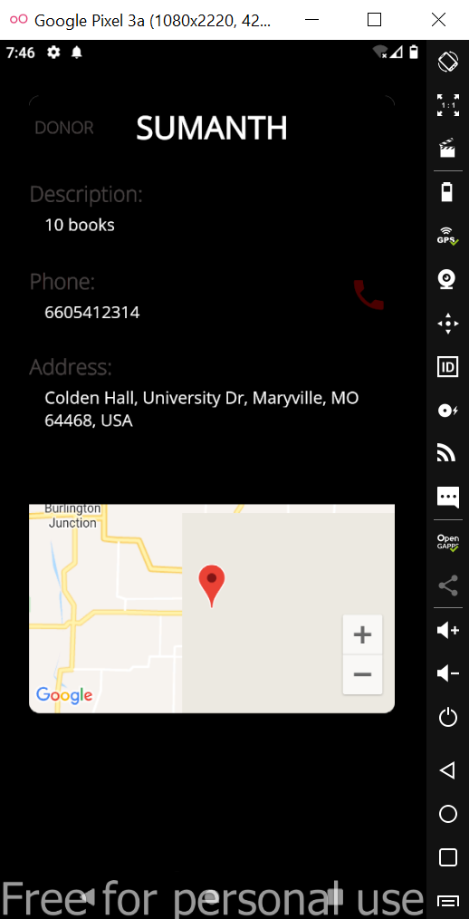
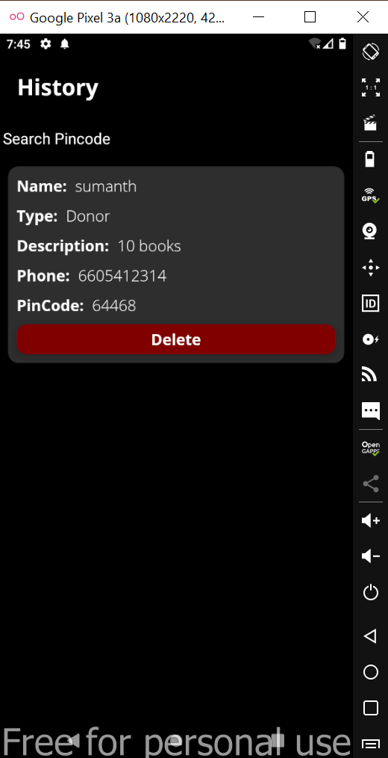
History page
User details page
History page
History page stores the entire details for either Donor or Receiver regarding the transaction.
A Donor or Receiver can search within nearby area by entering Pin code in search box at the top.
In order to differentiate between Donor and Receiver a ‘Type’ field is used which displays the requirement of the user.
If the receiver raise a request in receiver screen that information is stored here, and a Donor can directly contact the receiver and vice versa.
by clicking the card view will navigate the details page as shown in the fig.
Rohan

Slide 16
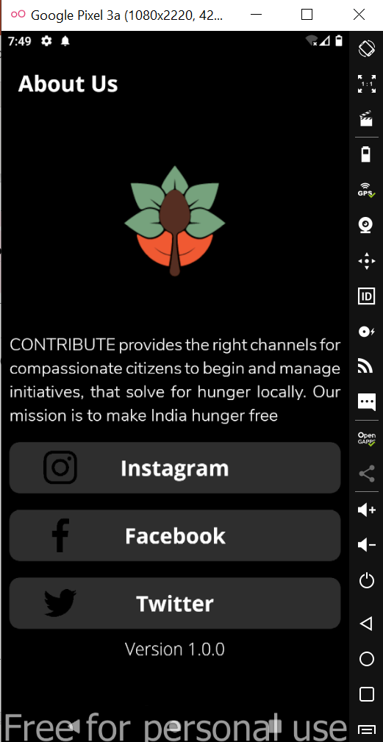
About Us page
If any user wants to quickly understand the vision of the application, they can navigate here.
All the activities and donations around the organizations are maintained in our social media platforms.
A user can be navigated directly to respective social media platform like Instagram, Facebook and Twitter by just one touch.
Shruthi

Slide 17
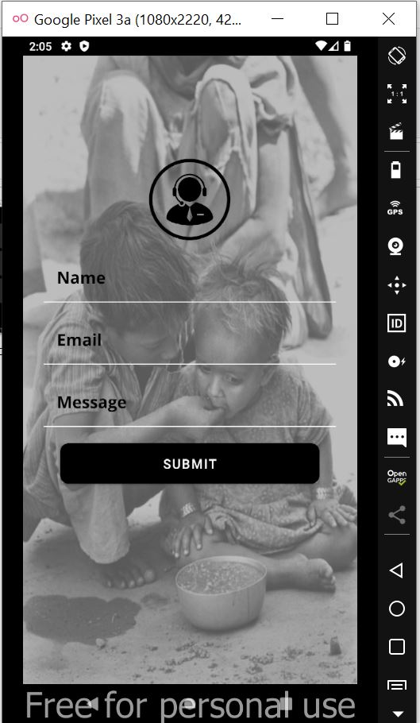
Contact Us page
For any app related queries or issues with application user can submit his details.
A dedicated person will contact the user who raised queries/ issues.
All the fields are mandatory in order to receive the support.
Shruthi

Slide 18
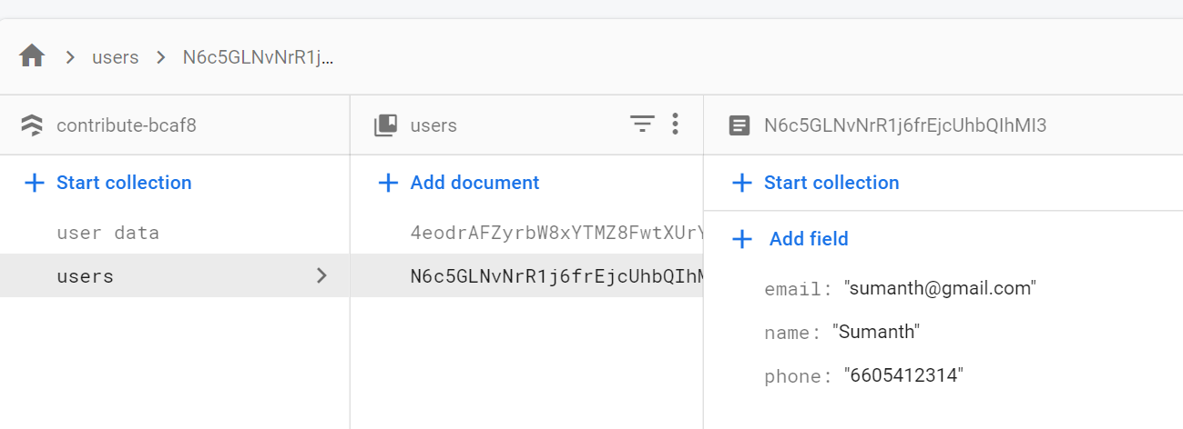
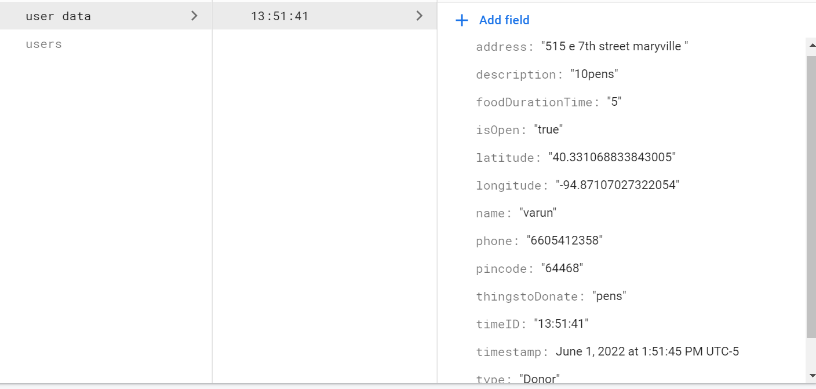
Firebase
Here is the data to store the information in firebase.
In the above fig shows USERS who are login.
In the below fig shows to store the information who entered whether if the donor or receiver.
Shruthi

Slide 19
Conclusion
In order to serve the people who are in need we have implemented Contribution management application.
Contributors can donate things in this app and receivers can pick up the things within the respective time limit .
If the time limit exceeds Goodwill will pick the contributed things to their warehouses.
Shruthi

Slide 20
Thank you

